Slide 1
ACMA 231
VBA:
If Statements, Loops, and Functions
1

Slide 2
If Statements - Excel
An IF statement is the most commonly used control statement
We’ve learned the Excel version:
=IF( {condition}, {value if true}, {value if false} )
  {Condition} is an expression that valuates to a Boolean (true / false) data type
  If the expression returns true, the {Value if true} expression is
returned. If false, the {Value if false} expression is returned
The VBA version works almost the same way. There’s just different notation and a little more flexibility

Slide 3
If …Then Statements
Below is an example of a simple If … Then statement in VBA
Read the statement like this:
– If the condition is true, Then execute the commands between then
and End If. If the condition is false, then go to the line after End If
The condition piece often features logical arguments (true, false, <, >, etc.)
Inside a condition, “=“ is test of equivalence. It is not an assignment statement
If {Condition} Then
{Stuff}
End If

Slide 4
If …Then … Else Statements
This expanded statement is analogous to the IF function in Excel
Read the statement like this:
– If the condition is true, Then execute the commands between then and Else. If the condition is false, then execute the commands between Else and End If.
If {Condition} Then
{Stuff}
Else
{Different Stuff}
End If

Slide 5
If …Then … ElseIf Statements
Read the statement like this:
  If the condition is true, Then execute the commands between then and ElseIf. If the condition is false, then …
  If the second condition is true, Then execute the commands between the second then and End If.
If {Condition} Then
{Stuff}
ElseIf {Different Condition} Then
{Different Stuff}
End If

Slide 6
If …Then … ElseIf … ElseIf … ElseIf ……. Else Statements
You can create very complex and robust if statements by combining the concepts on the past few slides
If {Condition} Then
{Stuff}
ElseIf {Condition 2} Then
{Stuff 2}
ElseIf {Condition 3} Then
{Stuff 3}
ElseIf {Condition 4} Then
{Stuff 4}
ElseIf {Condition 5} Then
{Stuff 5}
ElseIf {Condition 6} Then
{Stuff 6}
Else
{Stuff 7}
End If

Slide 7
Nesting
A control structure is said to be nested if it lives inside a control structure of a
similar type
These equivalent examples highlight a nested if statement in both Excel and VBA
The highlighted statements are nested because they are located entirely within the
confines of an existing if statement
VBA Statements
Function X(ByVal Y As Double) _ As Double
If Y <> 0 Then
If Y > 0 Then
X = Log(Y)
Else
X = Log(-Y)
End If
Else
X = 0
End If End Function
Excel Formula
=IF(A1<>0,IF(A1>0,LN(A1),LN(-A1)),0)
“<>” means not equal to

Slide 8
Two Observations When Using Functions
1. Using parentheses to enclose arguments while using functions:
– A simple rule: If a function call is the ONLY statement on the line, parentheses aren't needed.
Sub MsgBoxDemo4()
MsgBox "Hello World" End Sub
– Otherwise (if there are other statements or elements), parentheses MUST be added to distinguish function arguments and other statements
Sub MsgBoxDemo5()
Dim ans As Integer
ans = MsgBox("Continue?", vbYesNo) End Sub
Creating Custom Message Boxes with VBA MsgBox Function (automateexcel.com)

Slide 9
Two Observations When Using Functions
2. When you use a function, you can either
– supply arguments positionally, in the order that they appear in the procedure's definition:
Sub MsgBoxDemo6()
MsgBox "Choose Yes or No", vbYesNo, "Selection Window" End Sub
“Prompt”
“Buttons”
“Titles”
– or you can supply the arguments by name without regard to position:
Sub MsgBoxDemo3()
MsgBox prompt:="Hello World", Title:="This is a title" End Sub
A named argument consists of an argument name followed by a colon and an equal sign (:=), followed by the argument value.

Slide 10
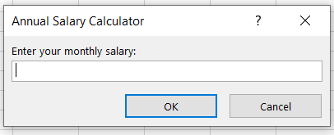
InputBox Function Example
Sub GetValue()
Dim Monthly As Integer
Monthly = Application.InputBox("Enter your monthly salary:", _ Title:="Annual Salary Calculator", Type:=1)
MsgBox "Annualized: $" & (Monthly * 12) End Sub
Restrict your input to
be numbers
Input box shows up when the code is executed:

Slide 11


For-Next Loops
For-Next Loops are an easy, extremely useful way to repeat a
structurally similar tasks many times over
Mathematical notation
n
n
∑ X_{i} i=1
∏ ^{X}i i=1
For i = 1 to n
Body of
Loop
Next i
If i = n + 1
No more looping; continue with code

Slide 12
For-Next Loop Format
Components of a For-Next Loop
  Index – Execution of the loop hinges upon the value of an index variable
    The Index should be an integer or long variable
    Don’t forget to declare the index as a variable first!
  Low Value – initial value an index takes
    On first loop iteration, Index = low value
  High Value – final value an index takes
    On final loop iteration, Index = high value
  Next – Must be at end of loop.
    If Index < High Value, Index increases by 1 and loop reruns (new iteration)
    If Index = High Value, code continues to the statement below Next
Read the statement like this:
  Run the loop (high – low + 1) times, each time increasing the value of the index by 1
For {Index} = {low} to
{high}
{Body of Loop}
Next {Index}

Slide 13
Do Loops
A Do Loop is another common control structure used for repeating sections of code
Two types:
  Execute loop While a certain condition exists
  Execute loop Until a certain condition exists
Uses of a Do Loop
  Brute force solve methods
  Parameter calibration (e.g.)
    Refine estimate while square error is greater than tolerance level
    Refine estimate until square error is less than tolerance level
Not as common as For Loops, but some notation is included in case you’re interested
Do While {Condition}
{Stuff}
Loop
Do Until {Condition}
{Stuff}
Loop

Slide 14

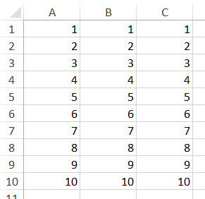
Some Looping Techniques
A usual application using loops is to populate value row by row, there are several ways to do it:
Use Offset method behind Range object.
Use Cells object.
Use Range object, incorporate a concatenation trick.
Sub LoopDemo()
Dim | i | As Integer
For | i | = 1 To 10
 | ' | Use Offset to populate col A
Range("A1").Offset(i - 1, 0).Value = i
RowOffset: How many rows to move down (negative means move up) ColOffset: How many column to move right (negative means move left)
' Use Cells to populate col B Cells(i, 2).Value = i
' Use concatenate and Range to populate col C Range("C" & i).Value = i
Next i End Sub

Slide 15
Some Looping Techniques
Range.Count method:
  Returns a value that represents the number of objects (cells), no matter empty or nonempty.
  For example, the following statement returns value 8.
MsgBox Range("A1:A8").Count
An important and useful technique: How to use VBA to determine how
many records in a table?
  This is a practical question because when you use For-Next loop, you always want to know how many loops should we do. (i.e. what is the High value?)
  In the following example, we are going to use combination of methods:
Count and End

Slide 16

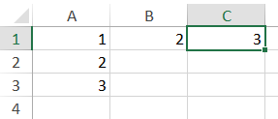

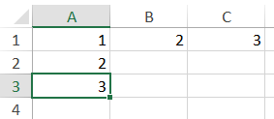
Some Looping Techniques
Range.End(Direction) method:
  Returns a Range object that represents the cell at the end of the region that contains the source range.
  The argument Direction could be: xlDown, xlToRight, xlToLeft or
xlUp
  For example:
Range("A1").End(xlToRight).Select
Ctrl + →
Range("A1").End(xlDown).Select
Ctrl + ↓

Slide 17

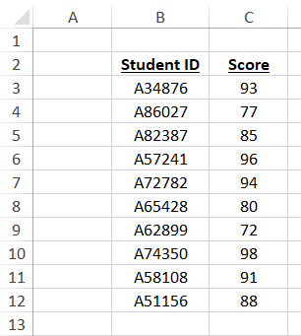
Some Looping Techniques
Use combination of Count and End to help us determine the number of records
for a data table:
– Another expression using Range object:
Range(Cell1, [Cell2]) object can hold two objects:
Range("A1:A5")
They are equivalent, both refer to the range from A1 to A5
Range(Range("A1"), Range("A5"))
From cell B3
Range(Range("B3"), Range("B3").End(xlDown)).Count
Count # of cells in this range
Ctrl + Shift + ↓
To the last cell in the column that contains cell B3

